Slide 1
Creating Web Pages
Lecturer: Meng Duc Bui Tien (Mr.)

Slide 2
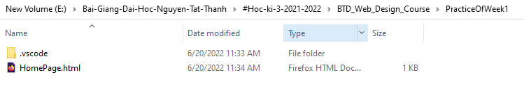
Creating Web Pages

Slide 3
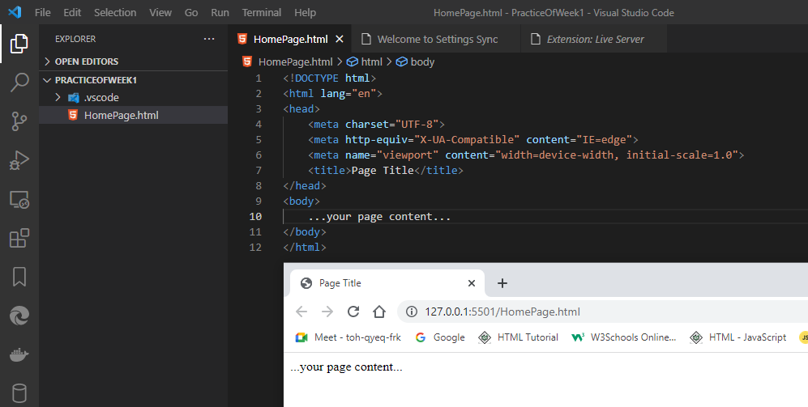
Structuring HTML
<!DOCTYPE html>
<html>
<head>
<title>Page Title</title>
</head>
<body>
...your page content...
</body>
</html>

Slide 4
Structuring HTML
<!DOCTYPE html>
<html>
<head>
<title>Page Title</title>
</head>
<body>
...your page content...
</body>
</html>

Slide 5
The <html> tag
The first page structure tag in every HTML page is the <html> tag. It indicates that the content of this file is in the HTML language
<!DOCTYPE html>
<html>
...your page...
</html>

Slide 6
The <head> tag
The <head> tag is a container for the tags that contain information about the page, rather than information that will be displayed on the page
<!DOCTYPE html>
<html>
<head>
<meta charset="UTF-8">
<meta http-equiv="X-UA-Compatible" content="IE=edge">
<meta name="viewport" content="width=device-width, initial-scale=1.0">
<title>Page Title</title>
</head>
...your page...
</html >

Slide 7
The <body> tag
The <head> tag is a container for the tags that contain information about the page, rather than information that will be displayed on the page
<!DOCTYPE html>
<html>
<head>
<meta charset="UTF-8">
<meta http-equiv="X-UA-Compatible" content="IE=edge">
<meta name="viewport" content="width=device-width, initial-scale=1.0">
<title>Page Title</title>
</head>
<body>
...your page...
</body>
</html >

Slide 8
The <title> tag
<title> tags are placed within the <head> tag and are normally used to describe the conte nts of the page
<!DOCTYPE html>
<html>
<head>
<meta charset="UTF-8">
<meta http-equiv="X-UA-Compatible" content="IE=edge">
<meta name="viewport" content="width=device-width, initial-scale=1.0">
<title>Page Title</title>
</head>
<body>
...your page...
</body>
</html >

Slide 9
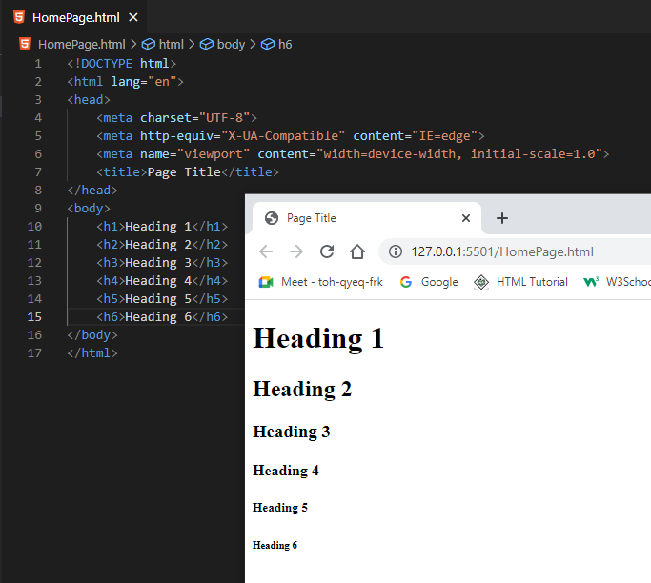
The <h1> tag, … <h6> tag (heading)
Headings are used to add titles to sections of a page. HTML defines six levels of headings. Heading tags look like the following:

Slide 10
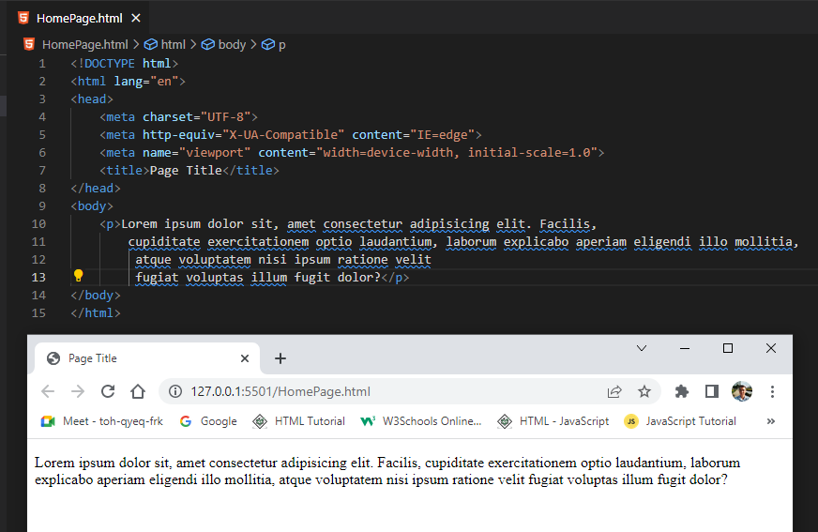
The <p> tag
Paragraphs are created using the <p> tag

Slide 11
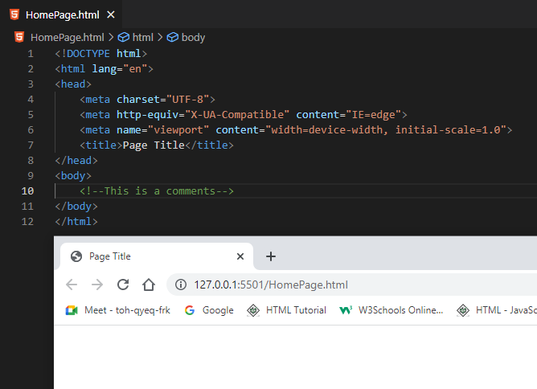
Comments into HTML pages
Put comments into HTML pages to describe the page itself

Slide 12
Organizing Information with Lists
How to create numbered lists
How to create bulleted lists
How to create definition lists
The Cascading Style Sheets (CSS) properties associated with lists

Slide 13
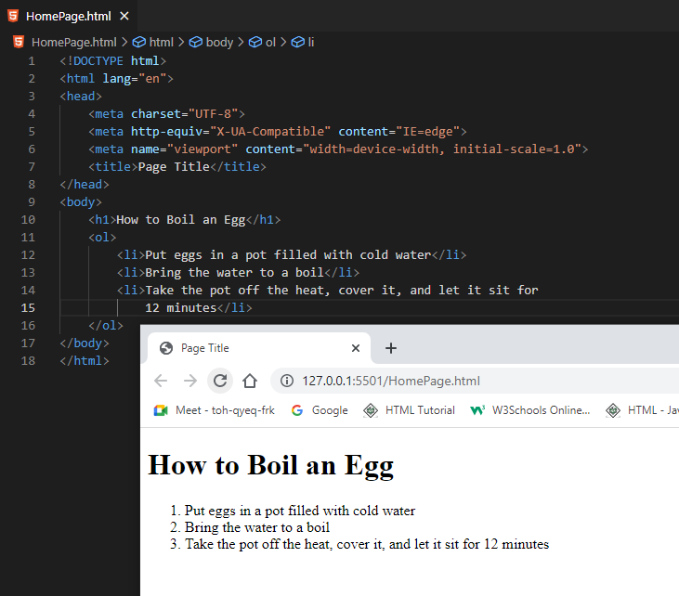
Numbered Lists
Numbered lists are surrounded by the <ol>...</ol> tags (ol stands for ordered list), and each item within the list is included in the <li>...</li> (list item) tag.

Slide 14
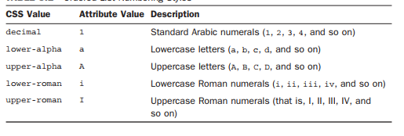
Numbered Lists
Specifying types of numbering in the <ol> tag using the style attribute, like this:
<ol style="list-style-type: lower-alpha;">

Slide 15
Numbered Lists
How to create numbered lists

Slide 16
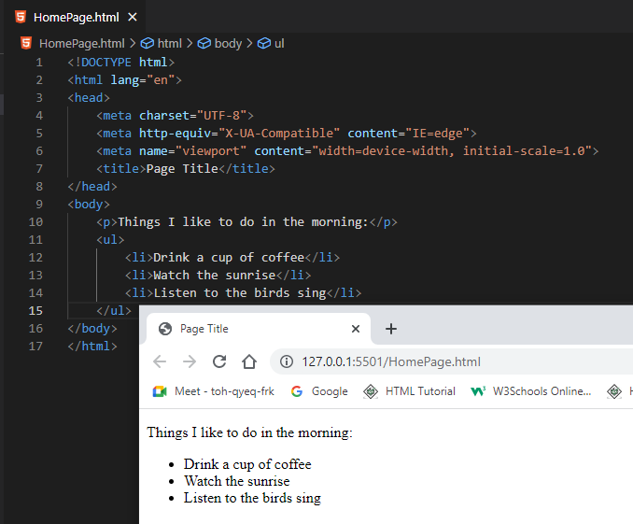
Unordered lists
Unordered lists are often referred to as bulleted lists

Slide 17
Customizing Unordered Lists
As with ordered lists, unordered lists can be customized using the type attribute or the list-style-type property
"disc" A disc or bullet; this style is the default.
"square" Obviously, a square rather than a disc.
"circle" As compared with the disc, which most browsers render as a filled circle, this value should generate an unfilled circle.

Slide 18
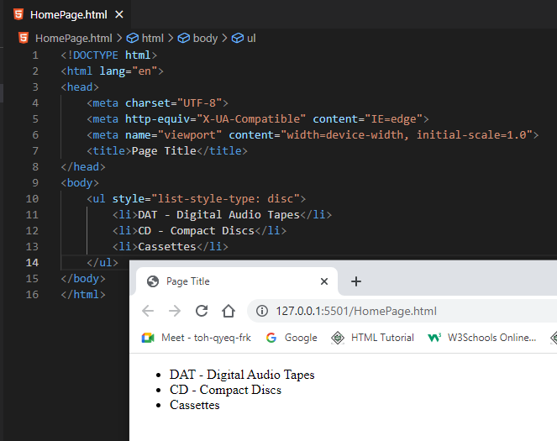
Customizing Unordered Lists

Slide 19
Customizing Unordered Lists

Slide 20
Definition Lists
Definition lists differ slightly from other lists. Each list item in a definition list has two parts: a term and the term’s definition
Each part of the glossary list has its own tag: <dt> for the term (definition term), and <dd> for its definition (definition description). <dt> and <dd> usually occur in pairs, although most browsers can handle single terms or definitions. The entire glossary list is indicated by the tags <dl>...</dl> (definition list).

Slide 21
Definition Lists
Definition lists differ slightly from other lists. Each list item in a definition list has two parts: a term and the term’s definition
Each part of the glossary list has its own tag: <dt> for the term (definition term), and <dd> for its definition (definition description). <dt> and <dd> usually occur in pairs, although most browsers can handle single terms or definitions. The entire glossary list is indicated by the tags <dl>...</dl> (definition list).

Slide 22
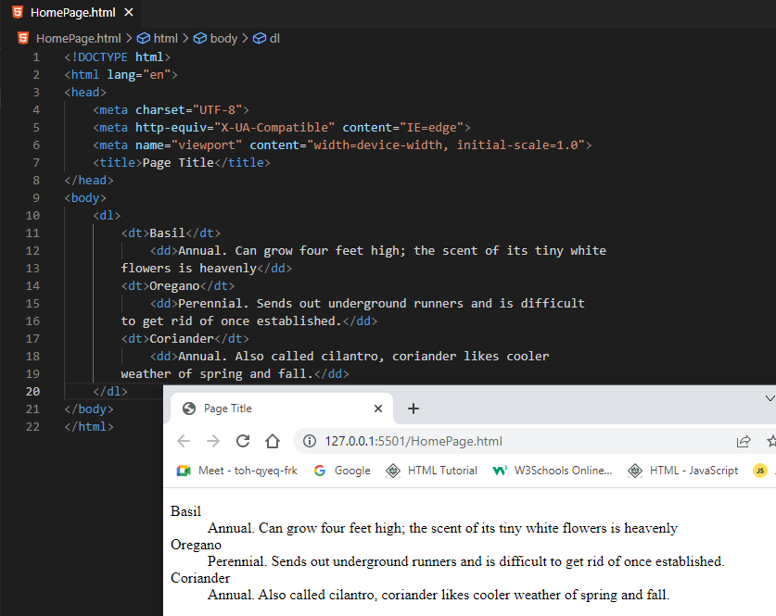
Definition Lists

Slide 23
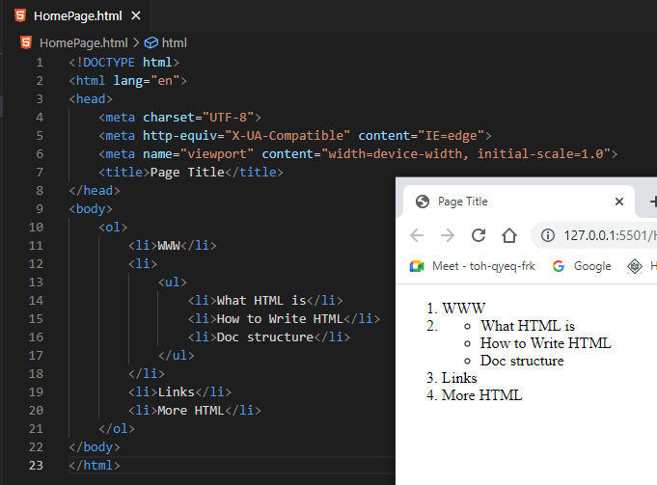
Nesting Lists
Indenting nested lists in HTML code itself helps show their relationship to the final layout

Slide 24
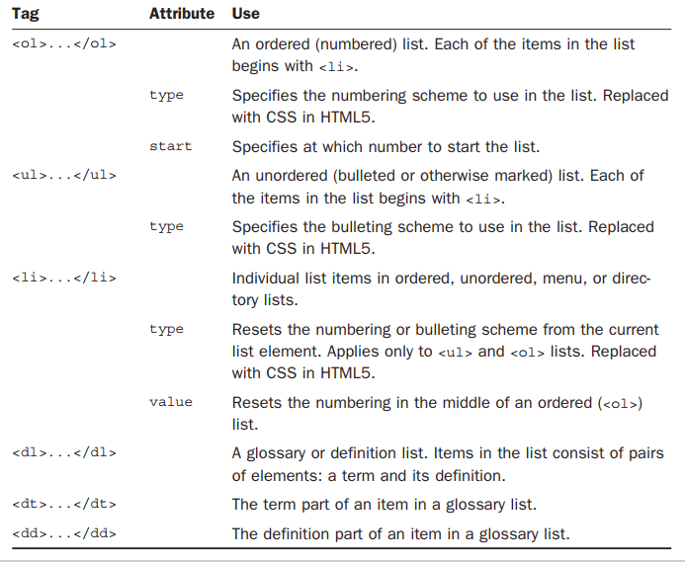
Other Uses for Lists

Slide 25
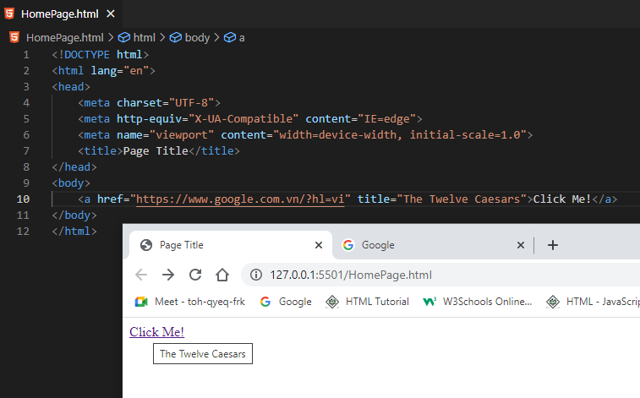
Working with Links
To create a link in HTML, need two things:
The name of the file (or the URL) to which you want to link
The text that will serve as the clickable link

Slide 26
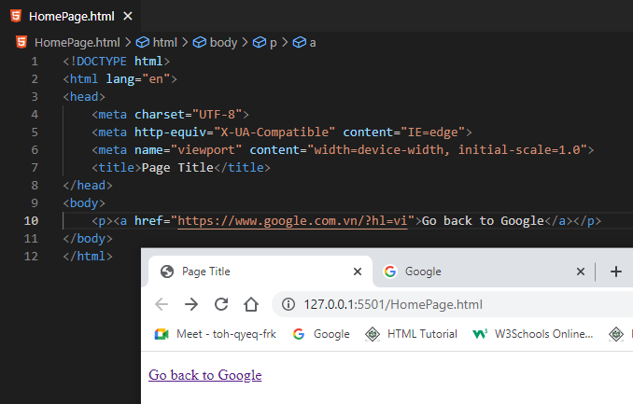
Nesting Tags Properly

Slide 27
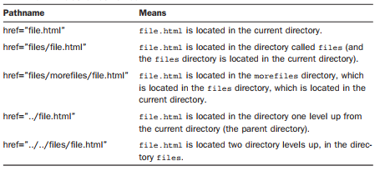
Absolute Pathnames

Slide 28


Slide 29
